Slide 1
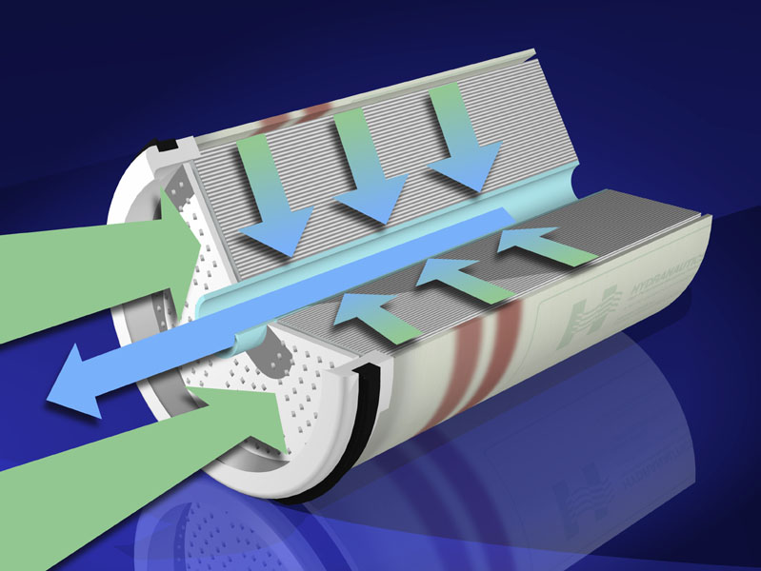
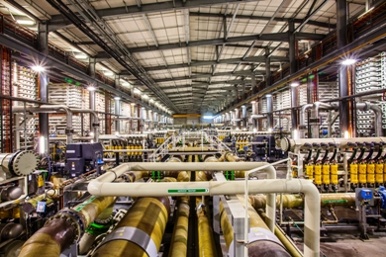
International Consulting
Services
Presentation for
Asian Development Bank
November, 2014
Overview of Desalination Trends and Jaffna Project
Nikolay VOUTCHKOV,PE, BCEE

Slide 2
Desalination – Where Are We Today?
16,000 Desalination Plants Worldwide –
66.4 Million m³/day
Source: IDA Desalination Yearbook 2013-2014

Slide 3
Desalination Market Drivers
Water Scarcity
Economic Growth
Population Growth

Slide 4
Membrane Desalination – Key Trends
SWRO Desalination Most Commonly Used
Large - (over 60 MLD) and Mega - (over 200 MLD) Desalination Plants Are the Wave of the Future
Most Large Urban Coastal Centers Worldwide Have Established a Target to Produce 25% of their Drinking Water from Desalination
Research &Development Activities are in 10-Year High – Likely to Yield Breakthroughs in Membrane and Desalination Technologies by 2015
Large SWRO Projects Are Aiming at Sustainability – Use of Alternative Power Supply Sources is On the Rise

Slide 5
Water Production Costs (Medium & Large SWRO Plants)
Classification | Cost of Water Production (US$/m³)
Low-End Bracket | 0.5 – 0.8
Medium Range | 1.0 - 1.5
High-End Bracket | 2.0 – 4.0
Average | 1.0

Slide 6
Main Factors Affecting Costs
Plant Size – Bigger is Better
Source Water Quality - TDS, Temperature, Solids, Silt and Organics Content
Product Water Quality – TDS, Boron, Bromides, Disinfection Compatibility
Concentrate Disposal Method
Power Supply & Unit Power Costs
Project Delivery Method & Financing
Other Factors:
Intake and Discharge System Type
Pretreatment & RO System Design
Plant Capacity Availability Target
Notes:
6

Slide 7
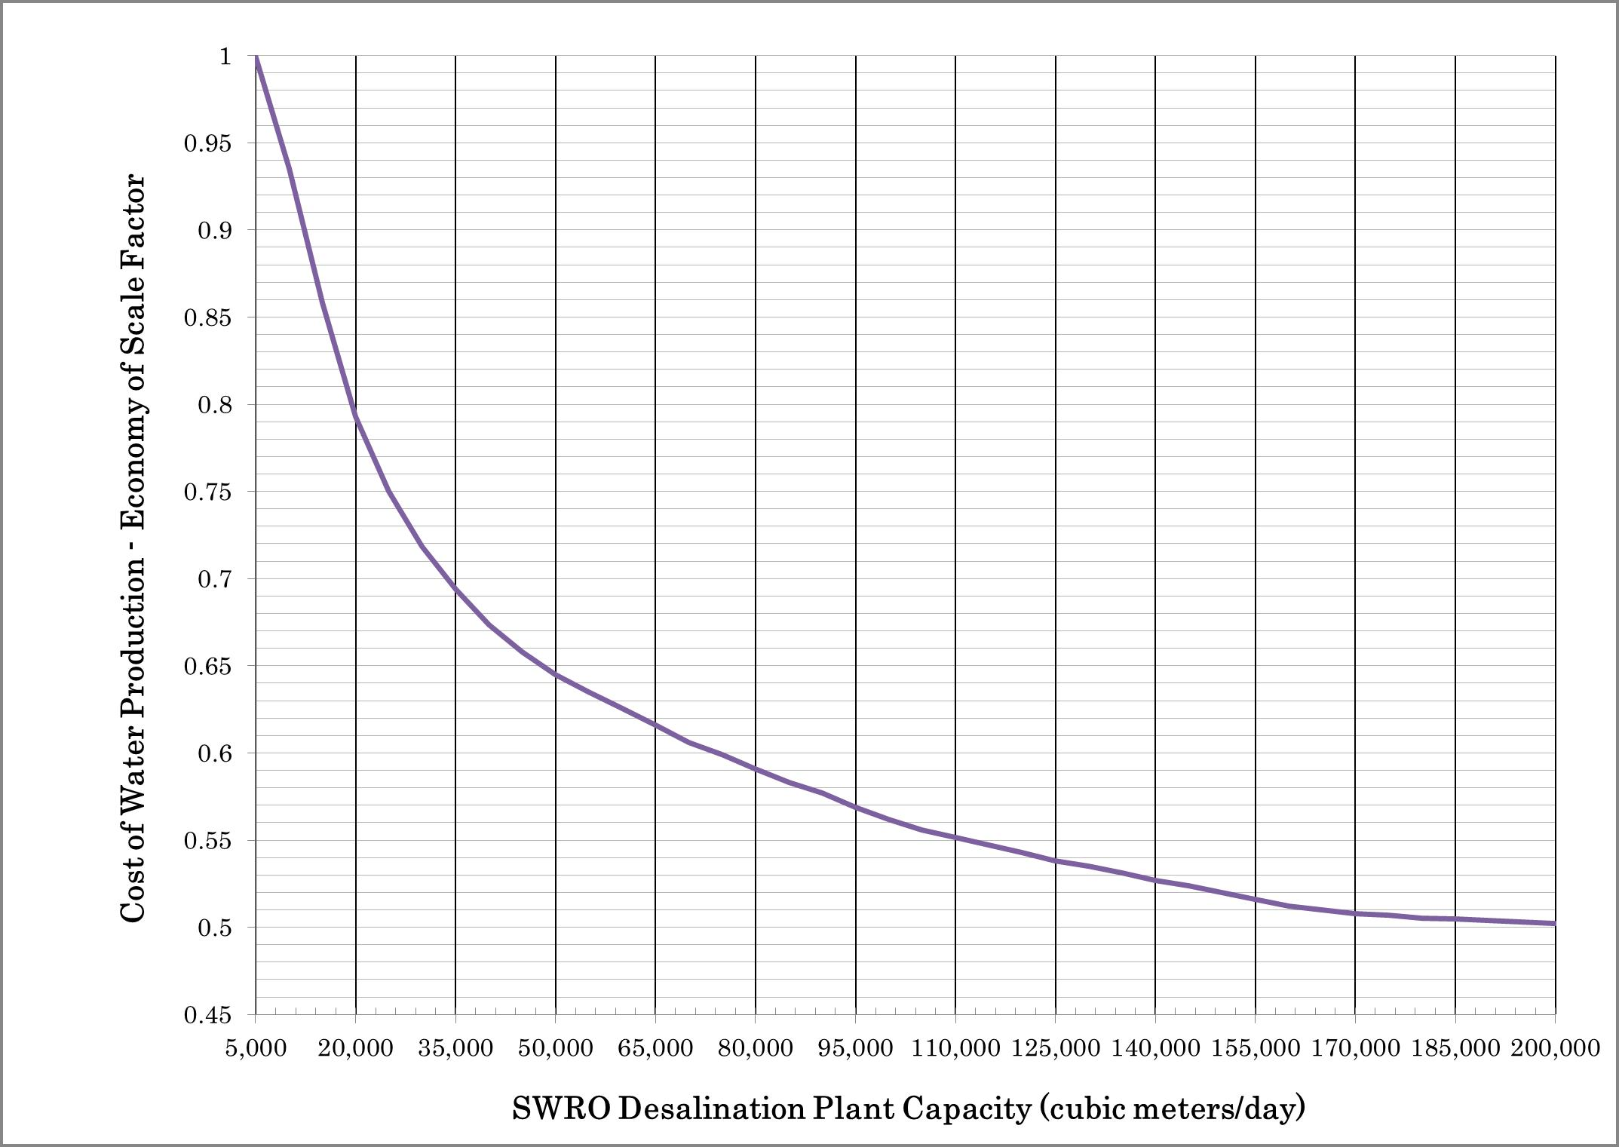
Plant Size and Construction Costs

Slide 8
Water Production Costs of Recent SWRO Desalination Projects

Slide 9
Key Reasons for Cost Disparity Between High-End & Low-end Cost Projects
Desalination Site Location (NIMBI vs. Science Driven)
Costly Plants Have Overly Long Product Water Delivery Pipelines
120 MGD Melbourne Plant – Cost of Plant/Delivery + Power Supply Systems =
US$1.7 BB/1.1 BB (50 miles)
66 MGD Sydney SWRO Plant – Cost of Plant/Delivery System
= US$560 MM/US$490 MM (10 miles of underground tunnel under Botany Bay).
Environmental Considerations
Complex Intakes & Diffuser Systems
Phasing Strategy
Intake and Discharge System Capacity
Pretreatment & RO System Design
Labor Market Pressures
Method of Project Delivery & Risk Allocation
Notes:
9

Slide 10
Energy Use for Membrane Desalination (Medium & Large SWRO Plants)
Classification | SWRO System Energy Use (kWh/m³)
Low-End Bracket | 2.5 – 2.8
Medium Range | 3.0 – 3.5
High-End Bracket | 4.0 – 4.5
Average | 3.0

Slide 11
TA-8668 SRI: Rapid Assessment of Seawater Desalination and Other Alternative Water Sources for Jaffna Water Supply
24 MLD Jaffna SWRO Plant
Preliminary Feasibility Analysis

Slide 12
Present Desalination Project Status
Six Alternative Sites in Jaffna Identified and Visited in September 2014
Two Sites Selected After Preliminary Screening:
Martuthankerni/Pallai
Kankesanthurai/Keerimalai
Initial Feasibility Evaluation Completed – Both Sites Fund Feasible
Draft Feasibility Study Submitted to ADB for Review in October, 2014

Slide 13
Martuthankerni/Pallai Site

Slide 14
Kankesanthurai/Keerimalai

Slide 15
Recommended Desalination Plant Configuration

Slide 16
Plant Intake and Outfall

Slide 17
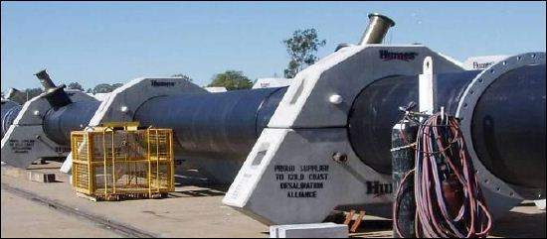
Concentrate Disposal
Outfall with Diffusers Designed
to Reduce Salinity Down to 10%
of Ambient Levels within 100 m of the Discharge

Slide 18
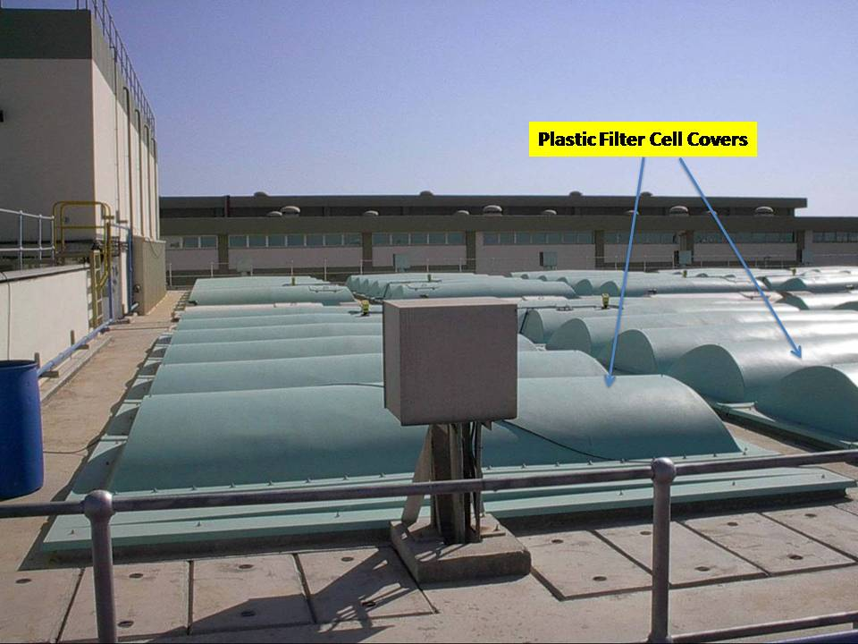
Gravity and Pressure Pretreatment Filters in Series
Stage 2 Pretreatment
Pressure Filters to Remove
Fine Solids & Silt
Stage 1 Pretreatment
Gravity Filters with Anthracite & Sand
to Remove
Algae, Coarse Solids and Suspended
Organics

Slide 19
RO Trains and Energy Recovery System
8 SWRO Trains Operating 20 hrs
per Day to Avoid Peak Power Tariff
8 Pressure Exchanger Trains
(one Per SWRO Train)
4 - ERI/PX-Q200 Units per Train
Energy Recovery Efficiency – 97%
Provides 50% of the Energy
Provides 2 % of the Energy
Provides 48% of the Energy

Slide 20
Summary of Plant Energy Use and Costs
Parameter | Martuthankerni/Pallai | Kankesanthurai/ Keermalai
Average Energy Use, kWh/m³ RO System Total Plant (w/o Delivery) | 2.27 3.20 | 2.27 3.33
Total Plant Power Demand, MW | 3.84(avg.)/4.80 (max) | 4.00 (avg.)/4.97 (max)
Capital Costs, in million US$ | 46.3 | 48.1
Annual O&M Costs, in million US$/year | 3.76 | 3.85
Annualized Capital Costs, US$/m³ (20 years loan @ 6 %) | 0.46 | 0.48
Annual O&M Costs, US$/m³ | 0.43 | 0.44
Total Cost of Water Production, US$/m³ | 0.89 | 0.92

Slide 21
Jaffna Desalination Plant – Capital Cost Breakdown
Construction Cost (CC)
US$34.6 – 36.0 MM
RO System –
36% of CC
Pretreatment –
13% of CC
Post-treatment –
3% of CC
Storage Tank –
5% of CC
Discharge Outfall –
8% of CC
Intake – 12%
of CC
Other Costs
– 35% of CC
Total Capital Cost
US$46.3 – 48.1 MM
Notes:
21

Slide 22
Energy Use of the Jaffna SWRO Plant
RO System –
74%
Product Water Delivery
2%
Pretreatment –
6%
(2.4 kWh/m³)
(0.1 kWh/m³)
(0.15 kWh/m³)
Other Facilities
8%
(0.25 kWh/m³)
Total Energy Use
3.20-3.33 kWh/m³
For TDS = 32 ppt &
Temp. = 29°C
Intake – 10%
(0.3 kWh/m³)
Notes:
22

Slide 23
Jaffna SWRO Project O&M Cost Breakdown
O&M Cost
US$0.43 – 0.44/m³

Slide 24
Selected Desalination Plant Sites

Slide 25
Water Delivery Systems from the Two Alternative Sites

Slide 26
Comparison of Costs for Water Production and Delivery from the Two Sites
Item | Capital Cost |  | Annual O&M Cost |  | Total Cost of Water
 | US$ million | Amortized US$/m³ | US$ Million/yr. | US$/m³ | US$/m³
Martuthankeri – Plant | 46.3 | 0.460 | 3.76 | 0.430 | 0.890
Martuthankeri - Conveyance | 32.6 | 0.324 | 0.55 | 0.062 | 0.386
Martuthankeri – Total System | 78.9 | 0.784 | 4.31 | 0.492 | 1.276
Kankesanthurai – Plant | 48.1 | 0.480 | 3.85 | 0.440 | 0.920
Kankesanthurai – Conveyance | 23.2 | 0.231 | 0.36 | 0.041 | 0.272
Kankesanthurai – Total System | 71.4 | 0.711 | 4.44 | 0.481 | 1.192

Slide 27
General Project Delivery Schedule

Slide 28
Next Project Implementation Steps
Completion of Environmental Impact Assessment & Additional Studies – 3 months (by Jan 2015)
Development of Contractor Procurement Documents – 3 Months (by Jan 2015)
Contractor Procurement & Selection – 4 months (by April 2015)
Land Acquisition – 6 months (by April 2015)
Project Funding (by July 2015)
Construction Begins – August 2015
Plant in Operation – September 2017

Slide 29
Concluding Remarks
Seawater Reverse Osmosis Desalination is Proven Technology with Over 20 Years of Worldwide Experience
Jaffna Desalination Project is Feasible
O&M Costs for the Fresh Water Production – US$0.43-0.44/m³
Project Capital Cost – US$46 to 48 million
Project Construction Period – 24 months
If Contractor Procured by April, 2014 the Plant Can be Operational by the Fall of 2017
Notes:
29

Slide 30
Questions ?
Nikolay Voutchkov, PE, BCEE
Water Globe Consulting
nvoutchkov@water-g.com
Nikolay Voutchkov

